Slide 1
MAC IC Portfolio
March 2017
Macro Team

Slide 2
Agenda
Portfolio Overview
Looking Forward
Financial Sector
TMT
Energy

Slide 3
I
Portfolio Overview

Slide 4
Mac IC Portfolio – Industries Excluding Cash

Slide 5
Mac IC Portfolio – Industry Breakdown
Identifier | Industry | Number of Holdings | Market Value | % of Portfolio
FI | Financial Institutions | 2 | $116,806.81 | 10.1%
EUI | Energy, Utilities & Industrials | 3 | $145,431.05 | 12.6%
MM | Metals & Mining | 2 | $155,867.14 | 13.5%
CHR | Consumers & Health Care | 1 | $48,382.36 | 4.2%
TMT | Technology, Media & Telecommunications | 5 | $292,019.42 | 25.3%
ETF | Exchange Traded Funds | 1 | $0.00 | 0.0%
Cash | Cash |  | $394,807.58 | 34.2%
 | Total |  | $1,153,314.36 | 100.0%

Slide 6
S&P/TSX Composite Sector Breakdown

Slide 7
Stock Betas
Stock | Beta | Shares Held | Market Value | Percentage | Weighted Beta
BlackBerry Ltd | 0.64 | 4,625 | $43,752.50 | 5.77% | 0.037
TransGlobe Energy Corporation | 0.68 | 9,375 | $21,468.75 | 2.83% | 0.02
Quebecor, Inc. | 0.48 | 1,892 | $74,809.68 | 9.86% | 0.047
Avigilon Corp | 1.81 | 2,348 | $34,703.44 | 4.58 | 0.083
TransAlta Renewables Inc | 0.46 | 4,900 | $72,814.00 | 9.6% | 0.044
Gluskin Sheff + Associates Inc | 1.00 | 2,900 | $53,737.00 | 7.08% | 0.071
Klondex Mines Ltd | -0.27 | 14,201 | $92,732.53 | 12.2% | -0.033
Halogen Software Inc | 0.51 | 6,835 | $71,254.88 | 9.4% | 0.048
Andrew Peller Ltd. | 0.21 | 4,484 | $48,382.36 | 6.4% | 0.013
Alaris Royalty Corp. | 0.84 | 2,787 | $63,069.81 | 8.3% | 0.07
BSM Technologies Inc | 0.68 | 41,666 | $67,498.92 | 8.9% | 0.061
Hudbay Minerals Inc | 2.83 | 5,973 | $63,134.61 | 8.32% | 0.24
Fortis Inc | 0.01 | 1,246 | $51,148.30 | 6.7% | 0.00067

Slide 8
Beta of the Portfolio
Portfolio Beta
0.70167

Slide 9
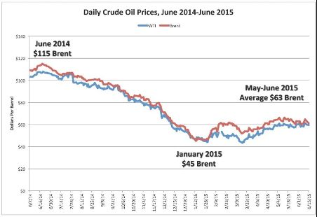
Portfolio Performance Timeline
TransGlobe Energy Corporation. Became a dividend paying company in 2014
Functional reserves in Yemen were significantly lower than in 2013
Reserves in the republic were reclassified
Yemeni Crisis (2011-Present)
Political turmoil
Oil prices have fallen sharply leading to significant revenue shortfalls
Notes:
TransGlobe Energy Corporation. Became a dividend paying company in 2014. Heavily invested in Egyptian opportunities. Functional reserves in Yemen were significantly lower than in 2013. Reserves in the republic were reclassified due to political instability and conflict. Yemeni Crisis (2011-Present) Political turmoil and threat from militants cause uncertainty and oil prices have fallen sharply leading to significant revenue shortfalls

Slide 10
Portfolio Performance Timeline Cont.
The main cause of the oil price collapse of 2014-2015 was due to over-production
From 2008 to 2015, U.S. and Canadian production increased 7.65 million barrels per day
Energy and Utilities compose a large portion of the S&P/TSX Composite Index while it makes up a smaller fraction of the MAC IC portfolio.
Financials holds the largest sector weight inside the S&P/TSX Composite Index
Notes:
Price collapse of oil in 2014 . The main cause of the price collapse of 2014-2015 was over-production of oil. Most of the increase came from unconventional production in the United States and Canada–tight oil, oil sands and deep-water oil. From 2008 to 2015, U.S. and Canadian production increased 7.65 million barrels per day
Energy and Utilities compose a large portion of the S&P/TSX Composite Index while it makes up a smaller fraction of the MAC IC portfolio.
Financials holds the largest sector weight inside the S&P/TSX Composite Index

Slide 11
Portfolio Holdings
 |  |  |  |  | Average | Market
Industry | Name | Symbol | Last Price | Shares Held | Cost Basis | Value
 | Cash |  |  |  |  | $394,807.58
TMT | BlackBerry Ltd | BB | $9.46 | 4,625 | $50,006.25 | $43,752.50
EUI | TransGlobe Energy Corporation | TGL | $2.29 | 9,375 | $37,507.50 | $21,468.75
ETF | BMO SP TSX CAPPED COMP IDX ETF | ZCN | $21.03 | 0 | $0.00 | $0.00
TMT | Quebecor, Inc. | QBR.B | $39.54 | 1,892 | $60,270.20 | $74,809.68
TMT | Avigilon Corp | AVO | $14.78 | 2,348 | $50,022.40 | $34,703.44
EUI | TransAlta Renewables Inc | RNW | $14.86 | 4,900 | $48,128.00 | $72,814.00
FI | Gluskin Sheff + Associates Inc | GS | $18.53 | 2,900 | $49,310.00 | $53,737.00
MM | Klondex Mines Ltd | KDX | $6.53 | 14,201 | $41,471.92 | $92,732.53
TMT | Halogen Software Inc | HGN | $10.43 | 6,835 | $47,718.30 | $71,254.88
CHR | Andrew Peller Ltd. | ADW.A | $10.79 | 4,484 | $50,006.60 | $48,382.36
FI | Alaris Royalty Corp. | AD | $22.63 | 2,787 | $50,008.78 | $63,069.81
TMT | BSM Technologies Inc | GPS | $1.62 | 41,666 | $50,009.20 | $67,498.92
MM | Hudbay Minerals Inc | HBM | $10.57 | 5,973 | $50,004.01 | $63,134.61
EUI | Fortis Inc | FTS | $41.05 | 1,246 | $50,011.98 | $51,148.30
 | Totals |  |  |  |  | $1,153,314.36

Slide 12
Portfolio Holdings Con’t
 |  |  | Unrealized | Realized | Cumulative | Total | Total
Industry | Name | Symbol | Gain (Loss) % | Gain (Loss) | Dividends | Gain (Loss) | Return %
 | Cash
TMT | BlackBerry Ltd | BB | (12.5%) | $0.00 | $0.00 | ($6,253.75) | (12.5%)
EUI | TransGlobe Energy Corporation | TGL | (42.8%) | $4,331.25 | $2,421.88 | ($9,285.63) | (18.6%)
ETF | BMO SP TSX CAPPED COMP IDX ETF | ZCN | 0.0% | $0.00 | $0.00 | $0.00 | 0.0%
TMT | Quebecor, Inc. | QBR.B | 24.1% | $0.00 | $567.60 | $15,107.08 | 25.1%
TMT | Avigilon Corp | AVO | (30.6%) | $0.00 | $0.00 | ($15,318.96) | (30.6%)
EUI | TransAlta Renewables Inc | RNW | 51.3% | $0.00 | $4,311.80 | $28,997.80 | 60.3%
FI | Gluskin Sheff + Associates Inc | GS | 9.0% | $0.00 | $3,190.00 | $7,617.00 | 15.4%
MM | Klondex Mines Ltd | KDX | 123.6% | $13,901.00 | $0.00 | $65,161.61 | 78.6%
TMT | Halogen Software Inc | HGN | 49.3% | $0.00 | $0.00 | $23,536.58 | 49.3%
CHR | Andrew Peller Ltd. | ADW.A | (3.2%) | $0.00 | $182.95 | ($1,441.29) | (2.9%)
FI | Alaris Royalty Corp. | AD | 26.1% | $0.00 | $376.25 | $13,437.28 | 26.9%
TMT | BSM Technologies Inc | GPS | 35.0% | $0.00 | $0.00 | $17,489.72 | 35.0%
MM | Hudbay Minerals Inc | HBM | 26.3% | $0.00 | $0.00 | $13,130.60 | 26.3%
EUI | Fortis Inc | FTS | 2.3% | $0.00 | $0.00 | $1,136.32 | 2.3%
 | Totals |  | 19.5% | $18,232.25 | $11,050.47 | $153,314.36 | 22.3%

Slide 13
Portfolio Returns Since Establishment

Slide 14
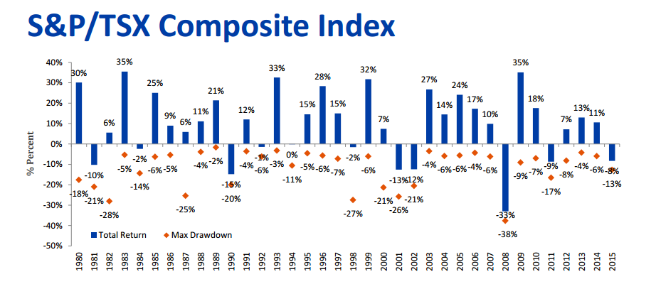
S&P TSX Drawdown

Slide 15
Portfolio Metrics – Since Establishment
Portfolio Risk Metrics | Daily | Annualized
Compounded Portfolio Return | 0.02% | 8.49%
Average Portfolio Return | 0.02% | 8.75%
Portfolio Variance | 0.00% | 0.43%
Portfolio Volatility | 0.34% | 6.54%
Portfolio Downside Variance | 0.000% | 0.148%
Portfolio Downside Volatility | 0.201% | 3.845%
Best Day |  | 1.66%
Worst Day |  | (1.59%)
Range |  | 3.25%
No Of Up Days |  | 311
No Of Down Days |  | 270
Up/Down Ratio |  | 1.15
Maximum Drawdown |  | (3.89%)
Risk Free Return: |  | 1.25%
Sharpe Ratio - Using:
Canada 10-Year Bond Yield |  | 1.15
5.0% |  | 0.57

Slide 16
Portfolio Metrics – Vs. Benchmark
Portfolio Risk Metrics | Daily | Annualized
Average Excess Return | 0.01% | 4.34%
Variance Of Excess Returns | 0.01% | 2.04%
Volatility Of Excess Returns | 0.74% | 14.27%
Information Ratio |  | 0.30
Portfolio Variance | 0.00% | 0.15%
Portfolio Volatility | 0.00% | 3.85%
Market Variance | 0.01% | 2.67%
Market Volatility | 0.85% | 16.33%
Covariance (Market & Portfolio) | 0.00% | 0.54%
Beta Of The Portfolio |  | 0.20
Average Portfolio Return | 0.02% | 8.75%
Average Market Return | 0.01% | 4.23%
Alpha Of The Portfolio |  | 7.90%

Slide 17
II
Looking Forward

Slide 18
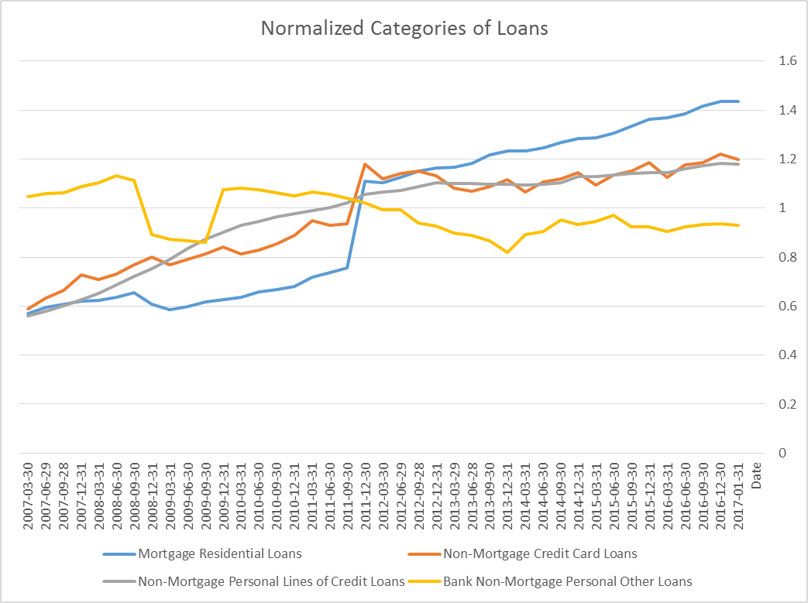
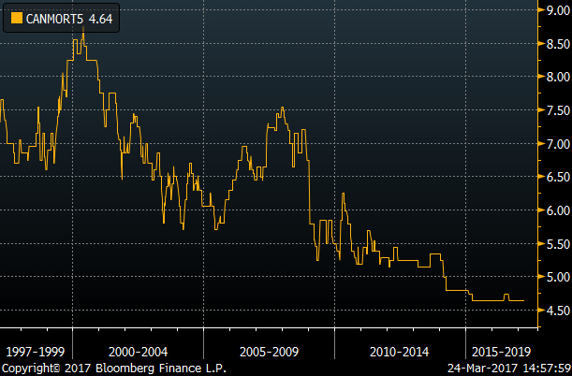
Looking Forward – Financial Sector
Larger loans are being taken out to finance housing in Canada, a result of low interest rates and the surge in prices
Canadian loans appear to be healthy, but changes in the interest rates and the change in demand for housing may be something to research
According to a Feb 2 report from CIBC, “…for 2017 we expect the pace of growth in mortgage originations to cool, reflecting factors such as reduced affordability, […] marginally higher mortgage rates and slowing activity in centers such as Vancouver
Notes:
Source: Bloomberg Terminal data
https://economics.cibccm.com/economicsweb/cds?ID=2272&TYPE=EC_PDF

Slide 19
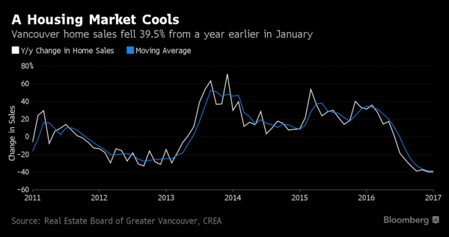
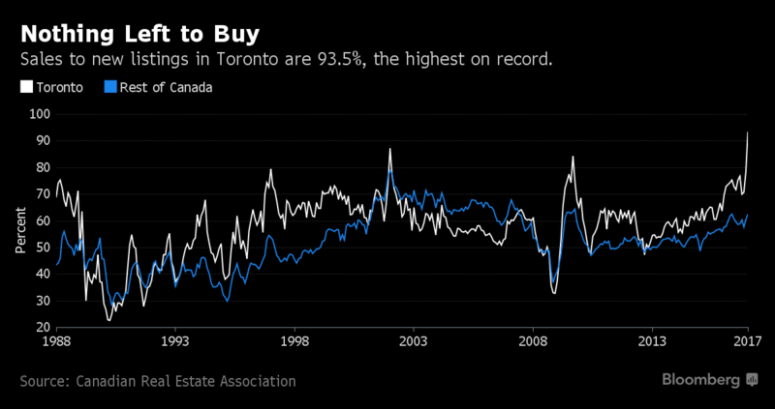
Looking Forward – Financial Sector
The surge in the price of housing in the metropolitan areas of Canada is caused by foreign investment
This can be seen by the number of sales moving from Vancouver (-40% in January) to Toronto (+28% in February) after Vancouver adopted a tax on foreign buyers
Ontario may be adopting a similar tax
This could present a huge problem for local homeowners because the tax will turn away the foreign money that created the surge
Notes:
Sources:
https://www.bloomberg.com/news/articles/2017-03-10/toronto-foreign-buyer-tax-won-t-solve-housing-woes-brokers-say
https://www.bloomberg.com/news/articles/2017-02-02/vancouver-home-sales-plunge-40-extending-string-of-declines

Slide 20
Looking Forward – Financial Sector
According to a Feb 2 article from CIBC, “Banks have been gaining market share […] portfolios are currently rising by more than 7% on a [YoY] basis.”
This could be an indicator of the banks’ confidence in the quality of these loans
Report calls for auto loans to advance by 4% in 2017
May be taking advantage of historically low interest rates
Notes:
https://economics.cibccm.com/economicsweb/cds?ID=2272&TYPE=EC_PDF

Slide 21
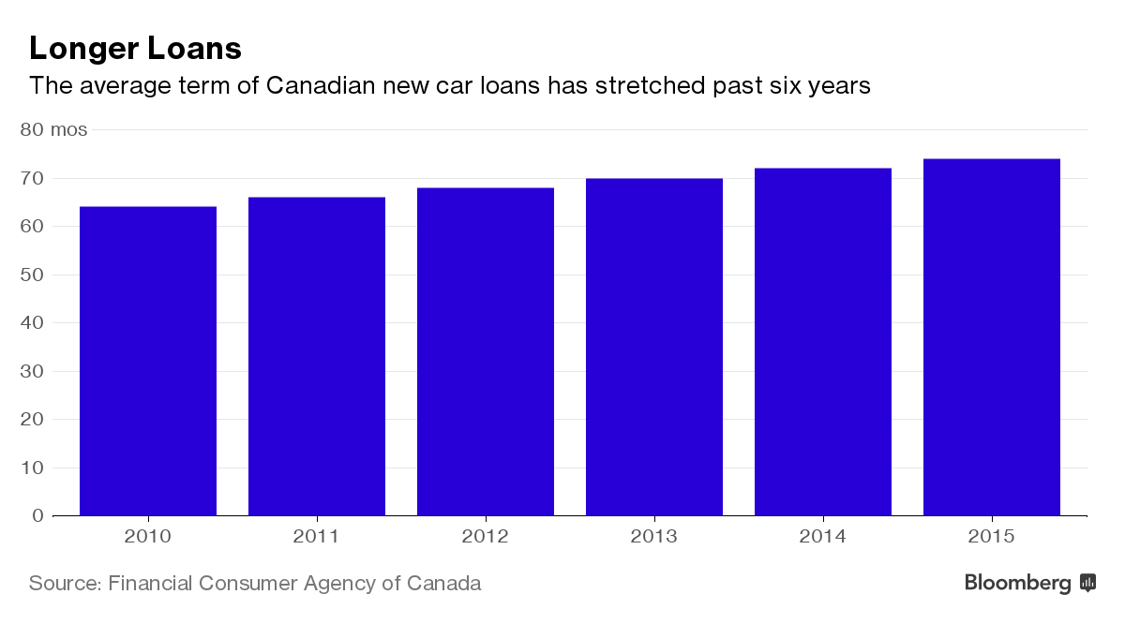
Looking Forward – Financial Sector
“The share of Canadians trading in vehicles with negative equity rose to 30 percent in 2015, and on average they were underwater by about C$6,700 ($5,000), according to statistics from J.D. Power.”
Canadians need to pay more for houses which leaves them with less disposable income causing more credit card debt and longer terms to pay for vehicles
“the Bank of Canada has repeatedly warned about dangerously high consumer debt levels that could magnify any economic shocks.”
Notes:
https://www.bloomberg.com/news/articles/2017-03-30/ford-seeks-to-curb-long-car-loans-as-canadian-debt-pile-mounts

Slide 22
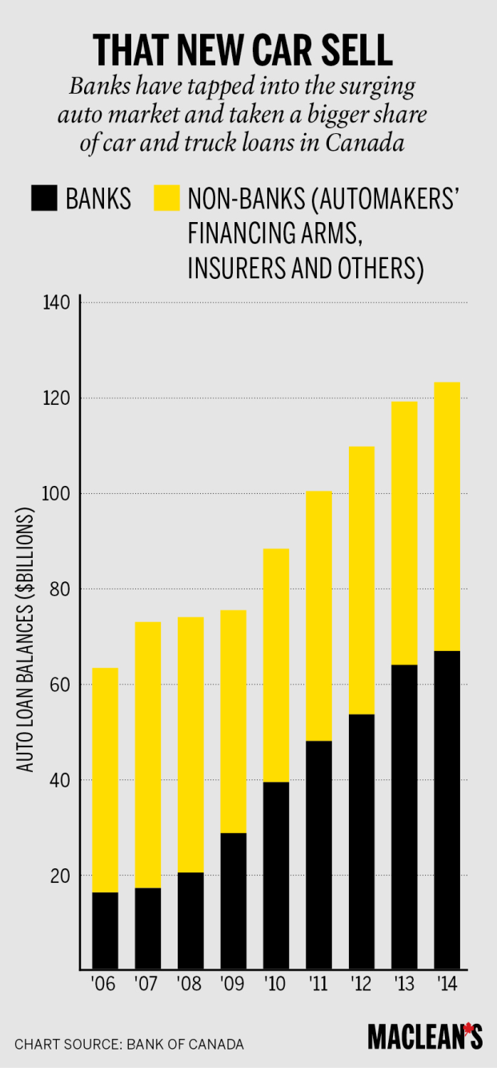
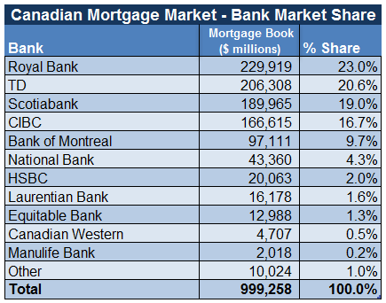
Looking Forward – Financial Sector
Analyst recommendation: Buy the dip
After the housing market relaxes, a great long-term opportunity will present itself in the form of REITs, banks, and other financing companies after a rate increase
The auto loan industry appears to be a good opportunity, however things may change as rates begin to increase
Notes:
https://www.canadianmortgagetrends.com/canadian_mortgage_trends/2016/01/top-banks-by-mortgage-portfolio.html

Slide 23
Looking Forward – TMT
Wireless Telecommunications
Low risk of competitors affecting the current key players
Wireless technology such as smartphones are becoming more of a necessity
The trend of “being connected” to the internet at all times through electronics forecasts an increase in demand for wireless internet
5G is expected to be released near the end of 2017 which will make mobile data more attractive to the public
Steady revenue growth is projected for the next 5 years:
Notes:
Sources:
https://www2.deloitte.com/us/en/pages/technology-media-and-telecommunications/articles/telecommunications-industry-outlook.html#
http://clients1.ibisworld.com.libaccess.lib.mcmaster.ca/reports/ca/industry/default.aspx?entid=1415
http://clients1.ibisworld.com.libaccess.lib.mcmaster.ca/reports/ca/industry/default.aspx?entid=1267

Slide 24
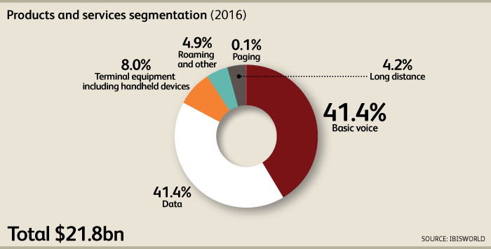
Looking Forward – TMT
Industry Snapshot
Revenue Breakdown
Revenue | $21.8
Profit | $8.2bn
Annual Growth (11-16) | 2.2%
Annual Growth (16-21) | 2.4%
Wages | $1.8bn
Industry Structure
Life Cycle Stage | Mature | Regulation Level | Medium
Revenue Volatility | Low | Technology Change | High
Capital Intensity | Medium | Barriers to Entry | High
Industry Assistance | Low | Industry Globalization | Low
Concentration Level | High | Competition Level | Medium

Slide 25
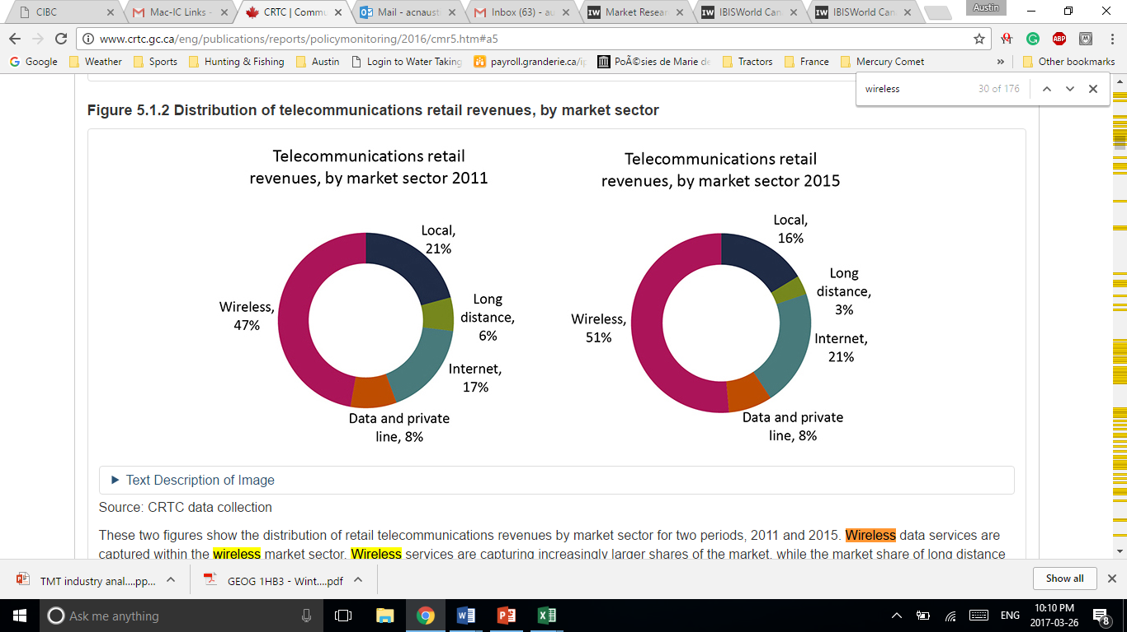
Looking Forward – TMT
Forecasted Performance
Telecommunication Retail Revenues
According to Ibis world the following sectors are projected to have decreasing and/or negative growth rates in the upcoming 5 years:
Newspaper publishing
Cable networks
Direct mail advertising
Data base & directory publishing
Telecommunication networking equipment manufacturing
Wired telecommunication carriers
Wireless telecommunication in Canada appears to be the sector with the steadiest growth within the TMT industry
Wireless appears to be taking over the telecommunications retail revenues

Slide 26
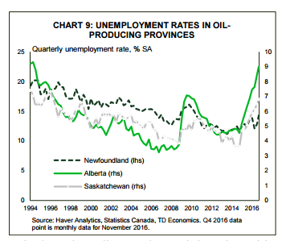
Looking Forward – Energy Sector
Unemployment rate in the oil sector has gone up over the past year in Newfoundland, Alberta, and Saskatchewan
Trudeau to enact nationwide carbon emission tax in 2018 uncertainty between American and Canadian energy expectations
Trump Administration to approve Keystone XL Pipeline
This will likely increase export capacity for Alberta oil boost manufacturing and lower the discount on lower Canadian oil prices

Slide 27
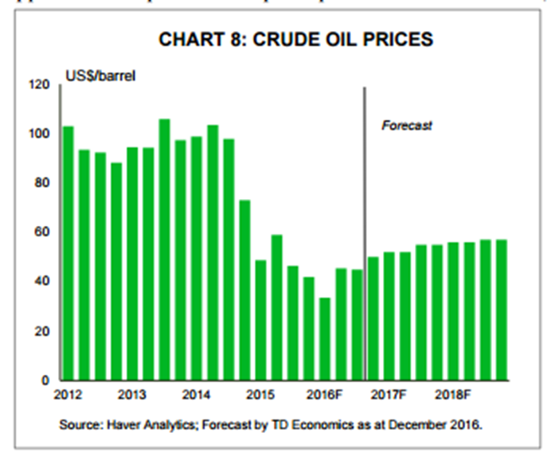
Looking Forward – Energy Sector
Trudeau to enact nationwide carbon emission tax in 2018 uncertainty between American and canadian energy expectations
Trudeau plans to approve Line 3 from Alberta to Wisconsin, and Trans Mountain from Alberta to B.C.’s coast
This would not only increase market access for Canadian oil and help to reduce the price differential, but could also provide an economic boost for the three westernmost provinces

Slide 28
Looking Forward – Energy Sector
Trudeau to enact nationwide carbon emission tax in 2018 uncertainty between American and Canadian energy expectations
Trudeau plans to approve Line 3 from Alberta to Wisconsin, and Trans Mountain from Alberta to B.C.’s coast
This would not only increase market access for Canadian oil and help to reduce the price differential, but could also provide an economic boost for the three westernmost provinces

Slide 29
Looking Forward – Energy
Consumer goods and industrials may be negatively affected and face restricted growth.
Limit number of companies in our portfolio that manufacture domestically or are heavily dependent on trade with the U.S. market
Oil effects price on the economy depends if it is transitory or more enduring
As a net exporter of crude oil, higher crude prices will boost profits at many energy companies. Higher prices will conversely lower the profits of energy usage intensive companies

